Slide 1
#CEHEFE
Improving collaboration between industry and universities/colleges for mutual benefit

Slide 2
Agenda
Welcome, introductions and apologies – chair
Recap – outcomes of the CE members forum on June 8th – Don Ward
Confirmation of objectives, development of draft terms of reference
Robin Nicholson, The Edge – Collaboration for Change
Confirmation of desired work programme
  A joint vision statement
  Case studies of successful HE/FE-industry impact (“farming the REF”)
  A joint guide/’top 10 ideas’ for HE/FE and industry to work better with each other
    New ways to give students tasters of business life
    New teaching models with industry
    Ways to influence HEFE teaching generally
  d) Jointly influencing professional institutions to improve the teaching curriculum
  e) An annual CE ‘wishlist’ of dissertation topics to be compiled with members steering group and theme groups.
Resourcing the above – including subgroups to take forward
Any other business
Dates, venues and agenda items for future meetings
  Dates & venues
  Agenda items

Slide 3
Members Forum June 2016
Improving collaboration between industry and universities/colleges for mutual benefit

Slide 4


Constructing Excellence
Not-for-profit think tank
and best practice organisation
A platform for industry improvement
to deliver better value
for clients, industry and users
through collaborative working
“Excellence through Collaboration”
Notes:
Our mission and simple vision statement are as shown. .

Slide 5
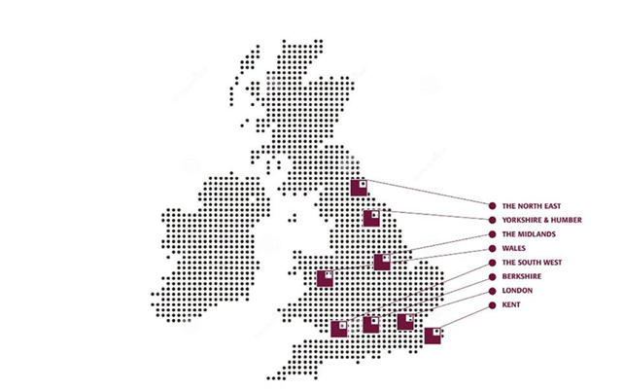


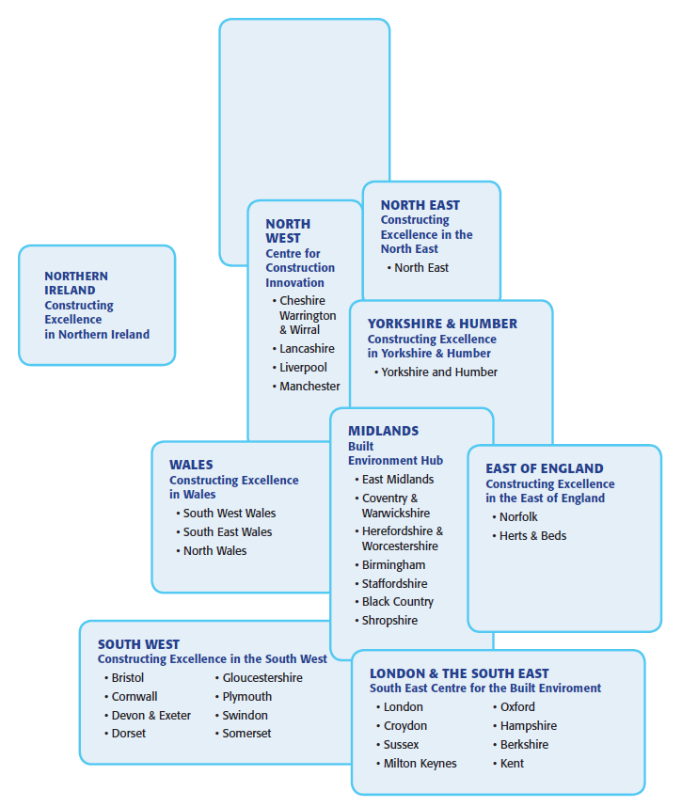


The Constructing Excellence movement
80 national members, 9 regional Centres, 35 local best practice Clubs (2000 members), 650 G4C members, 9 partners in the International Alliance
Notes:
5
Our Movement operates at a national, regional and local level within the UK – and increasingly internationally too.
We have a network of 9 regional centres covering England, Wales and Northern Ireland. These are separate organisations which carry the brand with a mission to deliver into that region or nation, often working closely with a university.
We also have over 30 local best practice clubs, each with their own independent volunteer committee, which reach out locally to SMEs by providing monthly breakfast or evening meetings, typically with a speaker on a Constructing Excellence theme and with the natural bi-product of networking.

Slide 6























































































National members
Clients at the heart
Notes:
This slide shows the national membership as of February 2016. Our membership is pan-industry, open to any organisation committed to positive change, from contractors and consultants to manufacturers and suppliers on the supply side, to public and private clients on the demand side. Clients are at the heart of Constructing Excellence, without them there is no industry, and client focus is a basic pre-requisite of we stand for.

Slide 7
Six core activities to support continuous improvement
Evidence
Core
activities
Action research & innovation
Networks
Guidance & training
Leadership & influence
KPIs & benchmarking
Demonstrations
Delivery
Notes:
7
7
The movement has six core activities as shown.
In summary
- gathering the evidence of successful innovation
- facilitating guidance, training and implementation services
- leading and influencing all stakeholders incl. Government
We are very clear about ensuring how we best add value – we avoid duplicating what other organisations do, and we seek to collaborate with others wherever possible to ensure maximum synergy and impact

Slide 8
National theme groups
Collaborative working champions
Digital construction (BIM)
Sustainability
Asset management
Nuclear
Procurement
Social value
Funding & finance
Water Benchmarking Club
CEHE
CCG
Health
Safety
Defects
G4C
Innovation

Slide 9
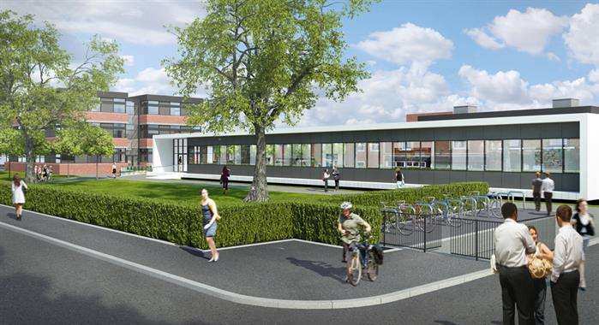
CE collaborating with HE/FE
Issues of mutual interest?
sector reputation
research agenda
curriculum content
employment
engagement, enterprise and impact with industry
How can we best support each others’ aspirations?
UTC Reading delivers computer science and engineering excellence for 14-19 year old students. The UTC was formed by a partnership between the University of Reading, Activate Learning, Reading College and industry sponsors. The project was shortlisted for project of the year in the London and South East Constructing Excellence Awards 2014.

Slide 10
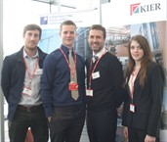
Proposed CE HE/FE work programme June 2016
A joint vision statement
Case studies of successful HE/FE-industry impact
A joint guide/’top 10 ideas’ for HE/FE and industry to work better with each other
New ways to give students tasters of business life
New teaching models with industry
Ways to influence HEFE teaching generally
Jointly influencing professional institutions to improve the teaching curriculum
An annual CE ‘wishlist’ of dissertation topics to be compiled with members steering group and theme groups
Constructing Excellence held their latest breakfast seminar at West Cheshire College’s science and technologies Campus in Chester….
The event focused on the investment in growth, skills and employment in the construction sector following the recession.

Slide 11
Agenda
Welcome, introductions and apologies – chair
Recap – outcomes of the CE members forum on June 8th – Don Ward
Confirmation of objectives, development of draft terms of reference
Robin Nicholson, The Edge – Collaboration for Change
Confirmation of desired work programme
  A joint vision statement
  Case studies of successful HE/FE-industry impact (“farming the REF”)
  A joint guide/’top 10 ideas’ for HE/FE and industry to work better with each other
    New ways to give students tasters of business life
    New teaching models with industry
    Ways to influence HEFE teaching generally
  d) Jointly influencing professional institutions to improve the teaching curriculum
  e) An annual CE ‘wishlist’ of dissertation topics to be compiled with members steering group and theme groups.
Resourcing the above – including subgroups to take forward
Any other business
Dates, venues and agenda items for future meetings
  Dates & venues
  Agenda items

Slide 12
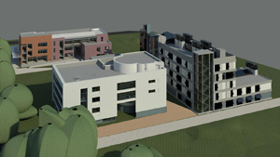
A joint vision?
CEHE 2013:
“The vision is of a future culture of innovation, realised in a
  ready interchange of access, knowledge and ideas for and from university research,
  modern fit-for-purpose curriculum content focused on leading edge thinking, and
  a quality pool of graduate talent for the industry,
all contributing to an advanced modern industrial sector.”
Dudley College Centre for Advanced Building Technologies and Construction Skills’ (CABTech) is featured in our programme of Cabinet Office trials of modern procurement approaches.

Slide 13
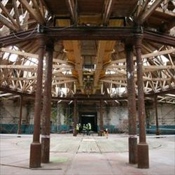
A joint manifesto?
eg
All major projects should attach to an HE/FE institution
All major projects should provide a teaching resource/opportunity
All alumni should offer practical support to their HE/FE institution
All companies should connect with and support at least their local HE/FE institution
All leading firms should appoint an HE and/or FE non-exec board member
Derby Roundhouse for Derby College, Constructing Excellence East Midlands Regional Project of the Year 2009, and National Runner-Up

Slide 14
Extra slides – breakout groups’ feedback at Members Forum June 2016
Improving collaboration between industry and universities/colleges for mutual benefit

Slide 15
Discussion themes
Research vision/agenda
Education curriculum/teaching methods
Attracting young people into our industry/HE/FE (“How do we prepare entrants to our industry for an industry that is so different to the industry that we inherited?”)
Graduate employment/employability
Are universities equipping the next generation with the skills and awareness of how to innovate?

Slide 16
Research vision/agenda
Integrating research and industry
Research can often be perceived as academic research for academic sake
Immediate benefit will be more beneficial to the industry
  Drip feeding research into industry
Integrating job roles, project management encourage to undertake research project
Recognition as topically experts within their business after carrying out research
Incentives within industry to undertake research are not significant enough
R&D tax credits – Increasing awareness of tax reliefs to encourage research
Sharing ideas and research (both positive and negative) outcomes with others in the industry
IP may be a potential barrier with sharing ideas outside our businesses
Communicating research with industry

Slide 17
Education curriculum/teaching methods
Skill shortage in industry and skill shortage in teaching
Teaching
  Secondments – Bring industry into the classroom
  Visiting lecturers
  Industry to access and influence content
  Industry led seminars
  Supply routes of academics into industry

Slide 18
Attracting young people into our industry/HE/FE
(“How do we prepare entrants to our industry for an industry that is so different to the industry that we inherited?”)
Stop assuming we know what the next generation want - Talk and ask generation Y what would encourage them into the industry
Remember the importance of generation X to influence generation Y
Role model within the industry to inspire to, difficult with a diverse industry
More marketing around the more ‘fun’ activities in the industry
Career progression
Better flexibility
Transferable skills around the world
Television show ideas aimed at teenagers – 24hrs on a construction site
Breadth of opportunities in the industry

Slide 19
Graduate employment/employability
Thin sandwiches to encourage more industry experience during your undergraduate degree
Skills gap between what industry need compared to what HE delivers
Natural collaborators
Improve the industry image
Lack of continuity for apprentices
School children on sites – other aspects of construction, BIM, Tablets, Smart Walls
FM education and passive house teaching
Match the skills being taught with the industry needs
Lack of understanding in business management and how the industry operates from teaching
Teach the industry not solely specialism
Cross contaminate – Academia to Industry and visa versa
Talk – Future skills to modern industry what business actually need

Slide 20
Are universities equipping the next generation with the skills and awareness of how to innovate?
Should universities be providing these skills?
Challenges of changing the curriculum
What do employers need? Do they need graduates to innovate?
What you are learning now in education only last 5 years
Create a culture during university to be creative and innovate
Target professional institutions

